Slide 1
Human Computer Interaction
Ms. Iqra Shahzad
Department of Software Engineering, NUML, Islamabad.

Slide 2
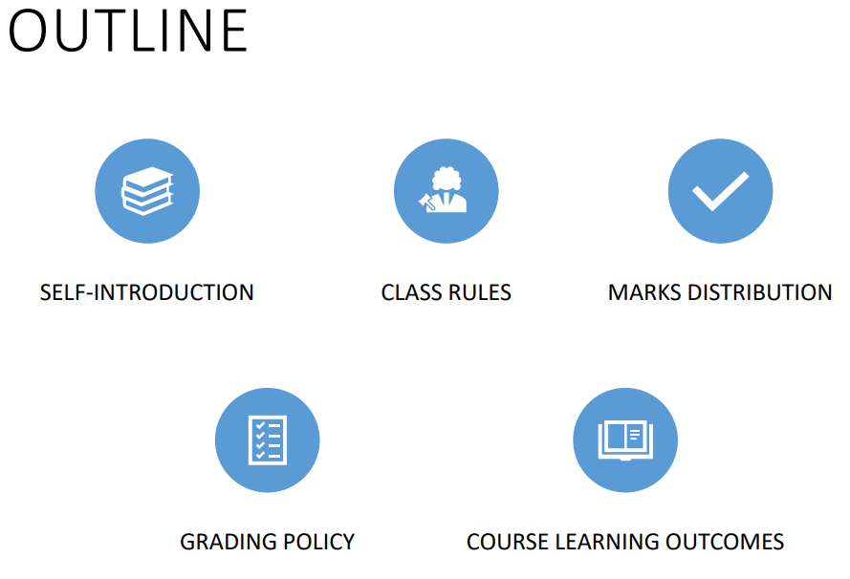

Slide 3
SELF-INTRODUCTION
MS(CSE)
NUST (2020)
Experience:
GVNU 2016-17
JSPSC 2019-2021
NUML 2021-Present
BS(CS)
IIUI(2014)
HCI
UI/UX
Big data visualization
blockchain
How to reach me?
Room no 21(basement)
iqra.shahzad@numl.edu.pk

Slide 4
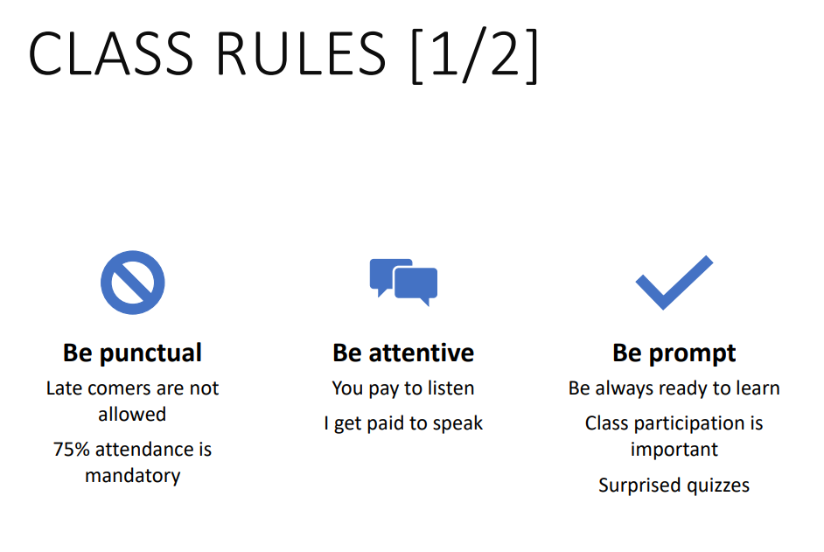

Slide 5
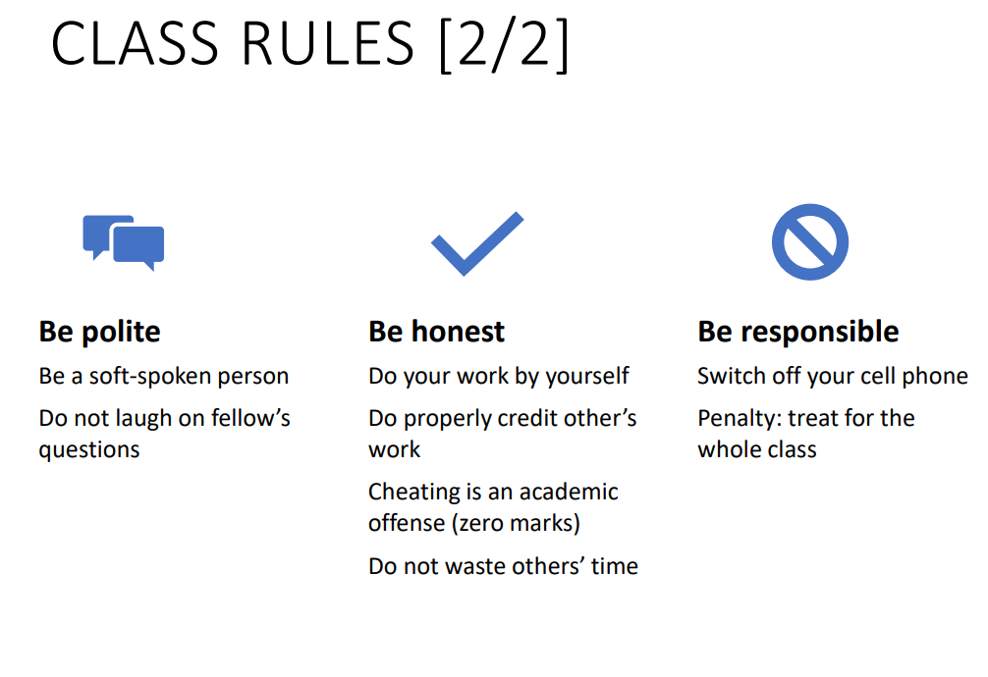

Slide 6
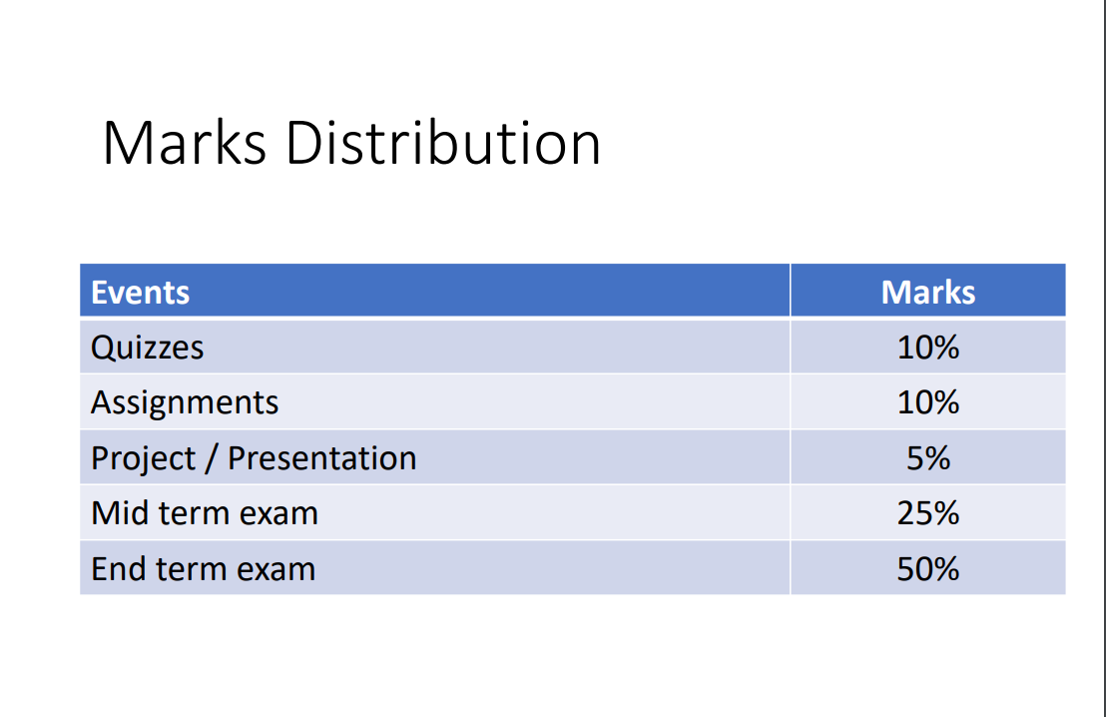

Slide 7

Grading policy

Slide 8
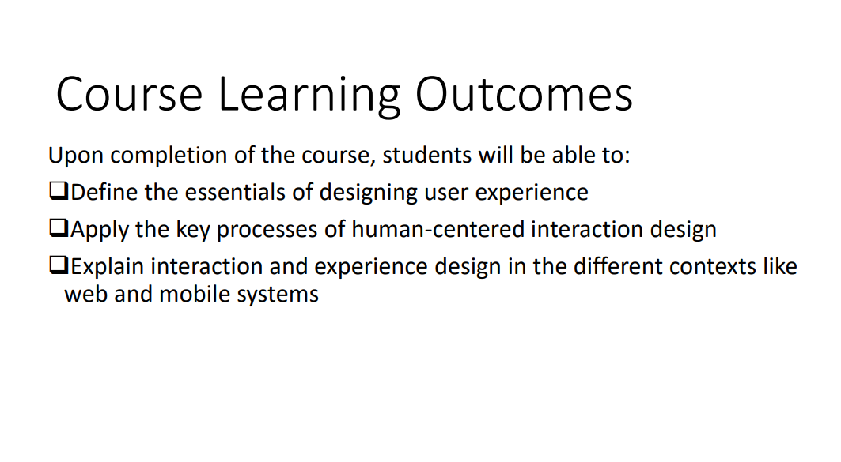

Slide 9
What is plagiarism?
Plagiarism is a specific form of cheating which is almost wholly found in respect of course assignments completed by students independently.
Plagiarism includes, but is not limited to:
1. using published work without referencing (the most common)
2. copying coursework essays
3. collaborating with any other person when the work is supposed to be individual
4. taking another person's computer file/program
5. submitting another person's work as one's own
6. the use of unacknowledged material published on the web
7. purchase of model assignments from whatever source
8. copying another student's results
Notes:
Everyone knows that plagiarism is something to be avoided, but not everyone is sure precisely what it is

Slide 10
reasons why students plagiaries
There are many reasons why students plagiaries, for example:
not being fully aware of what plagiarism is?
short-term panic response when an assignment is due and time is short
feeling a desperate need not to be seen as a failure and so copying to try to ensure “success”
different academic traditions

Slide 11
Positive Reasons for Not Plagiarizing
Pride in your work
Real Level of Attainment

Slide 12
Plagiarism in Practice – what is it?
Plagiarism takes many forms. Some of the more common are identified here:
Copying from a single source
Copying from several sources
Paraphrasing
Collusion(This can occur when students work together, and it is very important to distinguish when this is required, and when it has to end.)
Reuse of programming code
Use of multimedia

Slide 13
How to avoid plagerism
Making notes
Paraphrasing
Proper citation
Use of quotations

Slide 14
HCI or UI/UX wrt to plagiarism
Copying someone’s else design
Using someone else’s UX copy in your own designs without permission or attribution
Copying original media, banners, and logos without permission or attribution
Using or copying someone else’s UI kit without permission or attribution

Slide 15
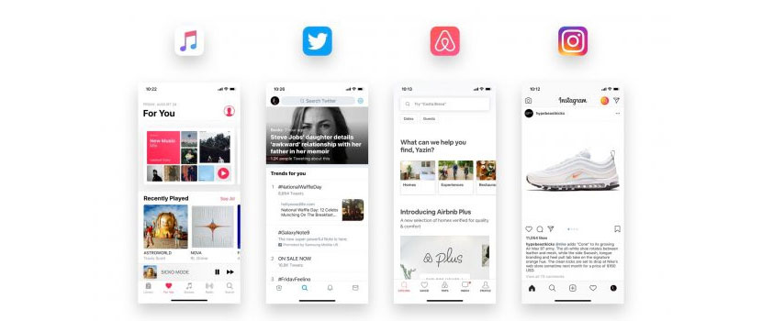
Users prefer a similar UI experience
Notes:
Many app uses common or similar ui

Slide 16
Introduction to HCI
Human-computer interaction (HCI) is defined as the field of study that focuses on
“optimizing how users and computers interact by designing interactive computer interfaces that satisfy users’ needs.”
Notes:
The study of human-computer interaction (HCI) focuses on designing, implementing, and evaluating interactive interfaces to enhance users’ experiences with computing devices.

Slide 17
The emergence of HCI dates back to the 1980s,
when personal computing was on the rise.
It was when desktop computers started appearing in households and corporate offices.
HCI’s journey began with video games, word processors, and numerical units.
Notes:
with the advent of the internet and the explosion of mobile and diversified technologies such as voice-based and Internet of Things (IoT), computing became omnipresent and omnipotent.

Slide 18
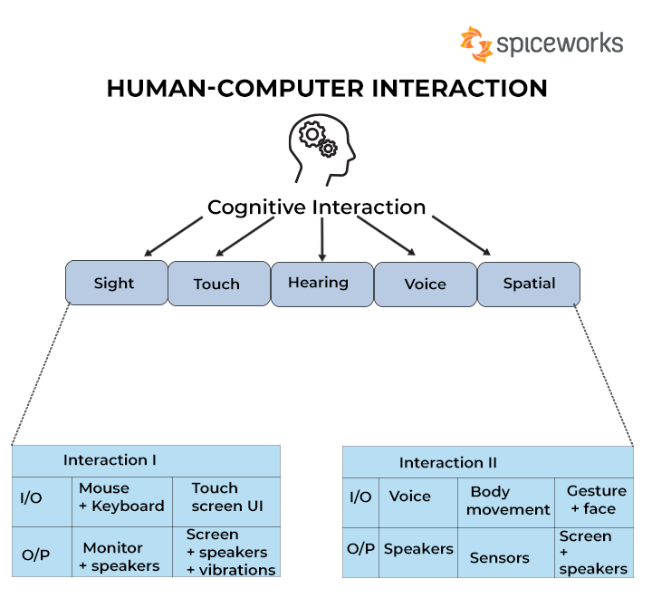
Today, HCI focuses on designing, implementing, and evaluating interactive interfaces that enhance user experience using computing devices. This includes user interface design, user-centered design, and user experience design.

Slide 19
Key components of HCI
Fundamentally, HCI is made up of these key components:
1-The user/ human
The user component refers to an individual or a group of individuals that participate in a common task. HCI studies users’ needs, goals, and interaction patterns. It analyzes various parameters such as users’ cognitive capabilities, emotions, and experiences to provide them with a seamless experience while interacting with computing systems.
System:
The product that user is using..
Notes:
The user component refers to an individual or a group of individuals that participate in a common task. HCI studies users’ needs, goals, and interaction patterns. It analyzes various parameters such as users’ cognitive capabilities, emotions, and experiences to provide them with a seamless experience while interacting with computing systems.

Slide 20
2- The goal-oriented task
A user operates a computer system with an objective or goal in mind. The computer provides a digital representation of objects to accomplish this goal. For example, booking an airline for a destination could be a task for an aviation website.
Notes:
A user operates a computer system with an objective or goal in mind. The computer provides a digital representation of objects to accomplish this goal. For example, booking an airline for a destination could be a task for an aviation website.

Slide 21
3- The interface /interaction
The interface is a crucial HCI component that can enhance the overall user interaction experience.
Various interface-related aspects must be considered, such as interaction type (touch, click, gesture, or voice), screen resolution, display size, or even color contrast.
Users can adjust these depending on the user’s needs and requirements.
Example:
For example, consider a user visiting a website on a smartphone. In such a case, the mobile version of the website should only display important information that allows the user to navigate through the site easily. Moreover, the text size should be appropriately adjusted so that the user is in a position to read it on the mobile device. Such design optimization boosts user experience as it makes them feel comfortable while accessing the site on a mobile phone.

Slide 22
Importance of HCI
HCI in daily lives: an ATM, food dispensing machine, or snack vending machine(interface , design…)
Industry: Industries that use computing technology for day-to-day activities tend to consider HCI a necessary business-driving force. Making employees comfortable
Accessible to disabled.
Usability and user experience
Business growth.

Slide 23
Examples of HCI
1. IoT technology
Eye-tracking technology
Speech recognition technology
4. AR/VR technology
Cloud computing

Slide 24
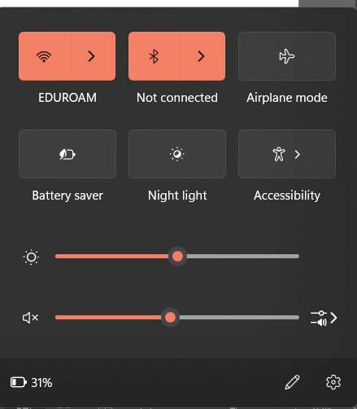
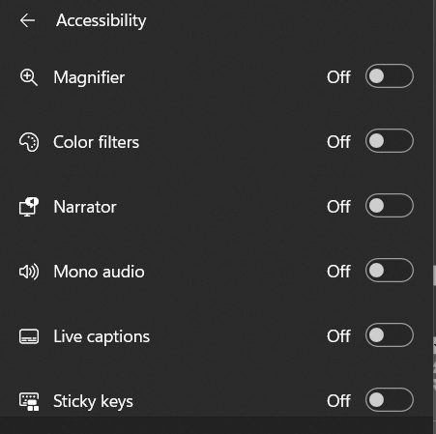
Multi-touch gestures enable interaction with touch screens through multiple fingers at once. They are especially useful because they permit numerous finger combinations and stroke gestures. This empowers touch screens to be some of the most useful input-output devices available.

Slide 25
Speech as Search Input is the use of oral commands to input a search query. You ask the computer to find you an answer. The technique often uses Artificial Intelligence technology, which can be difficult to implement.

Slide 27
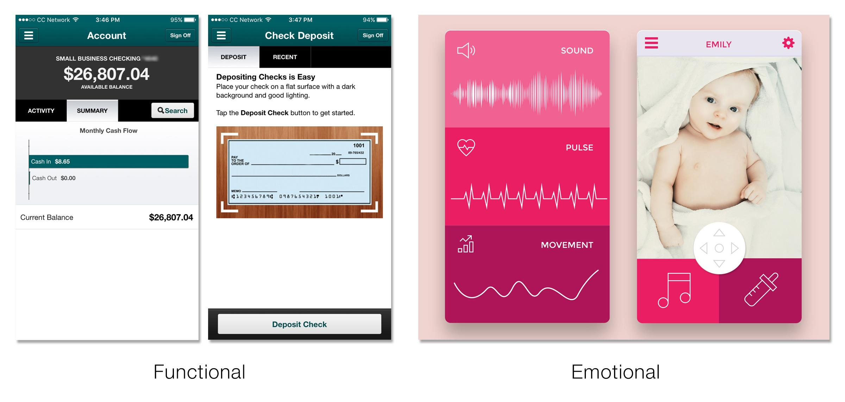

Slide 28

Describe two advantages of using an HCI when monitoring your fitness. Describe the disadvantages using an HCI might have in banking. • Cost and ease of use must be considered when designing any HCI.
1…The different display types and sizes that an HCI can be used on…
2…choices of function
Long-lasting and reliable. • Light and thin as often portable.
Disadvantages:
Cost and use of resources
Processing power

